Slide 1
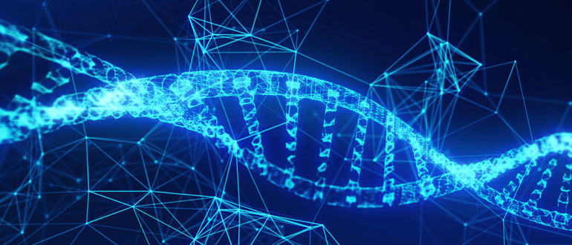

Deep Learning in Bioinformatics
By: Maninderpreet Singh Puri

Slide 2
Contents
What is Deep learning ?
Deep learning in bioinformatics
Deep learning models used in bioinformatics.
Case studies
Other applications
Conclusion
Q & A
References

Slide 3
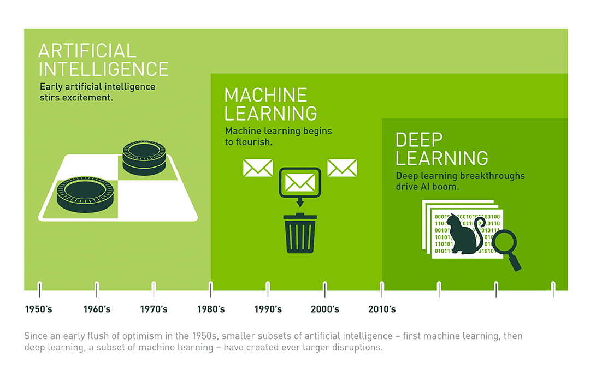
What is Deep learning ?
To achieve human intelligence, we need computers that learn like we do.
Humans are great at taking unstructured data and creating high level abstractions from it.
The high-level abstractions are then used for decision making.
Deep learning is a subset of Machine learning which be used on unstructured data or un-labeled data.
Deep learning algorithms can automatically learn high level abstractions from the data.
Feature learning
Figure 1 : Illustration of DL VS ML VS AI (COPELAND, 2016)
COPELAND, M. I. C. H. A. E. L. (2016, July 29). What’s the Difference Between Artificial Intelligence, Machine Learning and Deep Learning? NVIDIA.

Slide 4
Deep Learning versus Traditional Machine Learning
Traditional machine learning
Structured data
Hand engineered features
Fixed length input and output
Deep learning
Unstructured data
Feature learning
Variable length input and output
He, Z. (2021, March 2). Lecture 1: Introduction to deep learning [Slides]. La Trobe’s Learning Management System(LMS). https://lms.latrobe.edu.au/mod/resource/view.php?id=4740657

Slide 5
Traditional Machine Learning
Machine Learning
Input
Feature Representation
Learning
algorithm
Figure 2 : Traditional ML architecture
Traditional machine learning assume features are given to it
He, Z. (2021, March 2). Lecture 1: Introduction to deep learning [Slides]. La Trobe’s Learning Management System(LMS). https://lms.latrobe.edu.au/mod/resource/view.php?id=4740657

Slide 6
Deep Learning (Feature Learning)
Machine Learning
Input
Feature Representation
Learning
algorithm
Figure 3 : DL architecture
Move machine learning to include learning feature representation
Learn features automatically
He, Z. (2021, March 2). Lecture 1: Introduction to deep learning [Slides]. La Trobe’s
Learning Management System(LMS). https://lms.latrobe.edu.au/mod/resource/view.php?id=4740657

Slide 7
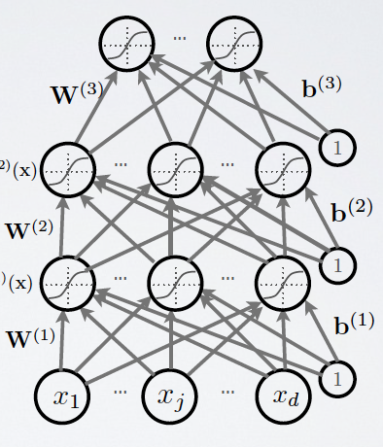


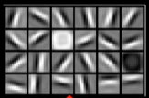

Feature Learning
During training the deep learning algorithm automatically builds hierarchy of features.
The top levels are high level features of the input data.
Classifying using high level features is much easier.
prob(car) prob(motorbike)
Motor bikes
X₂ (number of handlebars)
Decision boundary
Cars
X₁ (number of lights)
He, Z. (2021, March 2). Lecture 1: Introduction to deep learning [Slides]. La Trobe’s Learning Management System(LMS). https://lms.latrobe.edu.au/mod/resource/view.php?id=4740657

Slide 8
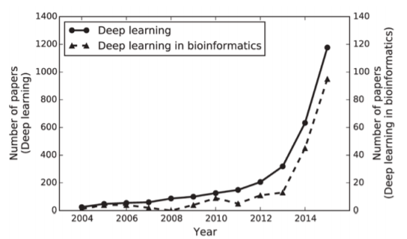
Deep learning in Bioinformatics
Deep learning is used in following bioinformatics domains:
omics (refers to a field of study in biological sciences that ends with -omics: genomics, transcriptomics, proteomics, or metabolomics)
biomedical imaging
biomedical signal processing
Figure 4 : Popularity of DL V/s DL in bioinformatics over the years
Min, S., Lee, B., & Yoon, S. (2016). Deep Learning in Bioinformatics. Deep Learning in Bioinformatics. Published. https://arxiv.org/ftp/arxiv/papers/1603/1603.06430.pdf

Slide 9
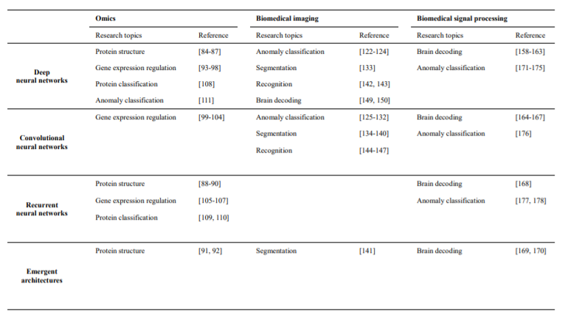
Deep learning in Bioinformatics (continued)
Deep learning architectures are basically artificial neural networks of multiple nonlinear layers and several types have been proposed according to input data characteristics and research objectives.
We categorized deep learning architectures into four groups (i.e., deep neural networks (DNNs) or (MLP), convolutional neural networks (CNNs), recurrent neural networks (RNNs), emergent architectures and explained each group in detail (Table 1).
Figure 5 : DL architecture with areas of applications
Min, S., Lee, B., & Yoon, S. (2016). Deep Learning in Bioinformatics. Deep Learning in Bioinformatics. Published. https://arxiv.org/ftp/arxiv/papers/1603/1603.06430.pdf

Slide 10
Deep learning in Bioinformatics (continued)
The goal of training deep learning architectures is optimization of the weight parameters in each layer, which gradually combines simpler features into complex features so that the most suitable hierarchical representations can be learned from data.
optimization process is organized as follows:
First, given a training dataset, the forward pass sequentially computes the output in each layer and propagates the function signals forward through the network.
In the final output layer, an objective loss function measures error between the inferenced outputs and the given labels.
To minimize the training error, the backward pass uses the chain rule to backpropagate error signals and compute gradients with respect to all weights throughout the neural network
Finally, the weight parameters are updated using optimization algorithms based on stochastic gradient descent (SGD) .
Min, S., Lee, B., & Yoon, S. (2016). Deep Learning in Bioinformatics. Deep Learning in Bioinformatics. Published. https://arxiv.org/ftp/arxiv/papers/1603/1603.06430.pdf

Slide 11
Deep learning in Bioinformatics (continued)
Another core element in the training of deep learning architectures is regularization, which refers to strategies intended to avoid overfitting and thus achieve good generalization performance.
For example, weight decay, a well-known conventional approach, adds a penalty term to the objective loss function so that weight parameters converge to smaller absolute values.
Currently, the most widely used regularization approach is dropout. Dropout randomly removes hidden units from neural networks during training and can be considered an ensemble of possible subnetworks
a new activation function, maxout, and a variant of dropout for RNNs called rnnDrop, have been proposed.
Min, S., Lee, B., & Yoon, S. (2016). Deep Learning in Bioinformatics. Deep Learning in Bioinformatics. Published. https://arxiv.org/ftp/arxiv/papers/1603/1603.06430.pdf

Slide 12
Deep learning in Bioinformatics (continued)
Deep learning libraries:
many open-source deep learning libraries are available online:
Python-based Neon
C++ based Caffe
Lua-based Torch
Python-based Theano
C++-based TensorFlow
Min, S., Lee, B., & Yoon, S. (2016). Deep Learning in Bioinformatics. Deep Learning in Bioinformatics. Published. https://arxiv.org/ftp/arxiv/papers/1603/1603.06430.pdf

Slide 13
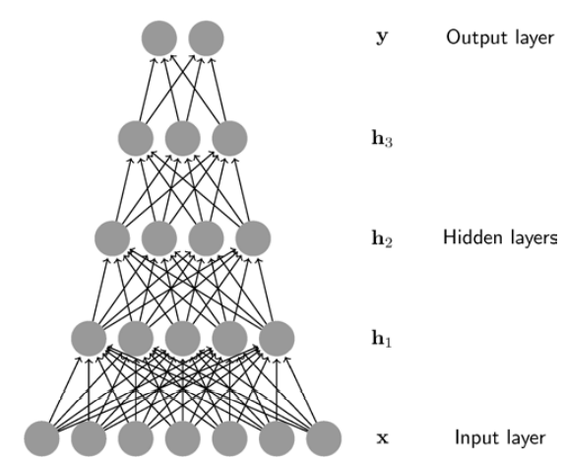
Deep learning models used in bioinformatics.
Deep neural networks
The basic structure of DNNs consists of an input layer, multiple hidden layers, and an output layer.
Once input data are given to the DNNs, output values are computed sequentially along the layers of the network.
At each layer, the input vector comprising the output values of each unit in the layer below is multiplied by the weight vector for each unit in the current layer to produce the weighted sum.
Then, a nonlinear function, such as a sigmoid, hyperbolic tangent, or rectified linear unit (ReLU), is applied to the weighted sum to compute the output values of the layer.
The computation in each layer transforms the representations in the layer below into slightly more abstract representations.
Given that bioinformatics data are typically complex and high-dimensional, DNNs have great promise for bioinformatics research. We believe DNNs, as hierarchical representation learning methods, can discover previously unknown highly abstract patterns and correlations to provide insight to better understand the nature of the data
Figure 6 : Deep Neural Network Architecture
Min, S., Lee, B., & Yoon, S. (2016). Deep Learning in Bioinformatics. Deep Learning in Bioinformatics. Published. https://arxiv.org/ftp/arxiv/papers/1603/1603.06430.pdf

Slide 14
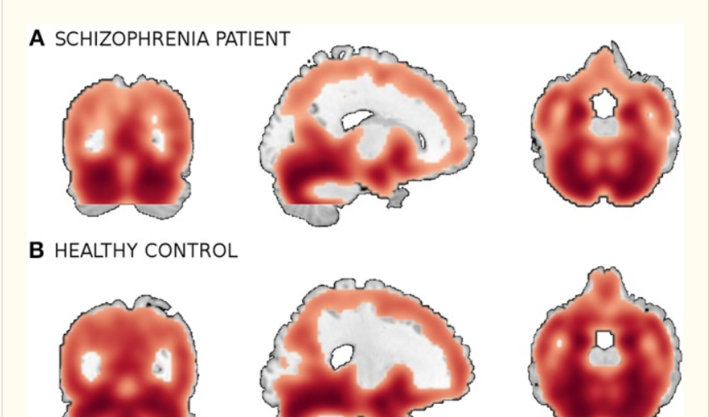
Case Study
Researchers conducted a deep learning study on neuroimaging . They used a combined MRI data from four separate schizophrenia studies conducted at 4 different institutions.
The combined sample comprised 198 schizophrenia patients and 191 matched healthy controls and contained both first episode and chronic patients.
Many preprocessing tasks were performed to get 60465 gray matter images which were used in the model.
They used a DBN(Deep Belief Network) to classify schizophrenia patients from brain MRIs. Deep Belief Network (DBN) is composed of multiple Restricted Boltzmann Machines (RBM) or autoencoders stacked on top of each other, where each hidden layer in subnetworks serves as a visible layer for the next layer.
Investigations show that deep learning has a high potential in neuroimaging applications
Figure 7 :
A smoothed gray matter segmentation of a training sample of (A) a patient and (B) a healthy control.
M. Plis, S. (2014). Deep learning for neuroimaging: a validation study.
Deep Learning for Neuroimaging: A Validation Study. Published. https://www.ncbi.nlm.nih.gov/pmc/articles/PMC4138493/

Slide 15
Other Applications
Applications in Omics:
protein structure prediction
Gene expression regulation
protein classification
anomaly classification to detect cancer.
Applications in Biomedical Imaging (using MRI, radiographic imaging, positron emission tomography (PET), and histopathology imaging.)
anomaly classification to diagnose diseases such as cancer or schizophrenia
Segmentation ] (i.e., partitioning specific structures such as cellular structures or a brain tumour)
Recognition (i.e., detection of cell nuclei or a finger joint).
Applications in Biomedical signal processing
Brain decoding using EEG signals
Anomaly classification to diagnose diseases.
Min, S., Lee, B., & Yoon, S. (2016). Deep Learning in Bioinformatics. Deep Learning in Bioinformatics. Published. https://arxiv.org/ftp/arxiv/papers/1603/1603.06430.pdf

Slide 16
Conclusion
In bioinformatics, where great advances have been made with conventional machine learning, deep learning is anticipated to produce promising and better results.
However, there remain many potential challenges, including limited or imbalanced data, interpretation of deep learning results, and selection of an appropriate architecture and hyperparameters.
Min, S., Lee, B., & Yoon, S. (2016). Deep Learning in Bioinformatics. Deep Learning in Bioinformatics. Published. https://arxiv.org/ftp/arxiv/papers/1603/1603.06430.pdf

Slide 17
Q & A

Slide 18
References
COPELAND, M. I. C. H. A. E. L. (2016, July 29). What’s the Difference Between Artificial Intelligence, Machine Learning and Deep Learning? NVIDIA.
He, Z. (2021, March 2). Lecture 1: Introduction to deep learning [Slides]. La Trobe’s Learning Management System(LMS). https://lms.latrobe.edu.au/mod/resource/view.php?id=4740657
Min, S., Lee, B., & Yoon, S. (2016). Deep Learning in Bioinformatics. Published. https://arxiv.org/ftp/arxiv/papers/1603/1603.06430.pdf
M. Plis, S. (2014). Deep Learning for Neuroimaging: A Validation Study. Published. https://www.ncbi.nlm.nih.gov/pmc/articles/PMC4138493/

